Slide 1

Y5,6
Friday 17th October – Monday 20th October 2025

Slide 2
Mr Scholey
Miss Winfield
Mrs Mann
Mrs Coxhead
Mr Adams
Mrs Oxley
Mrs Tubb
Mrs Ogden

Slide 3
Sleeping Arrangements
Separate rooms for boys & girls
We will allocate pupils to groups/ rooms and pupils will be told these on arrival.
Taken friendships etc into consideration in addition to dynamics of whole group

Slide 4

Team Building
Independence
Resilience
Creativity
Co-operation
Perseverance
Adventure
FUN
!!!

Slide 5


Kit List
Prepare for all weathers!
No mobile phones
Games eg. top trumps for evenings, book, colouring
Disposable lunch for arrival day
There will be plenty of food- snacks are not needed
Bedding- duvet and pillow cases
Swimming kit
Label everything
Pack your own case- tick lists are good
Max. £5 to spend in gift shop on site, £1 coin for swimming locker.
Don’t forget your Teddy!
We want to encourage independence therefore your child will be responsible for their own belongings. They also need to be able to carry everything themselves and their case/bag needs to fit under their bed.

Slide 6
Behaviour and Safety
It is extremely important that all children uphold expectations of behaviour and safety throughout the residential in the same way they would in school. Our usual behaviour policy applies.
If any child behaves in a way that compromises their own safety or that of others a risk assessment will be conducted and this may result in the need for them to be collected by parents.
There are times when children will be unsupervised in their dormitories- including during the night. Any behaviour which compromises safety and wellbeing will be dealt with seriously- this includes bullying, climbing, use of mobile phones and inappropriate use of fire escapes. If deemed appropriate, fair and proportionate this may lead to immediate exclusion from the residential and there may be further consequence upon return to school.
A behaviour agreement must be signed for your child to attend and we encourage you to talk with your child about behaviour and safety in advance, in order to reinforce our messages.

Slide 7
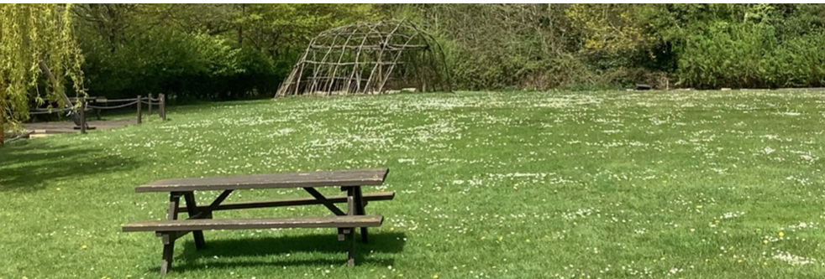
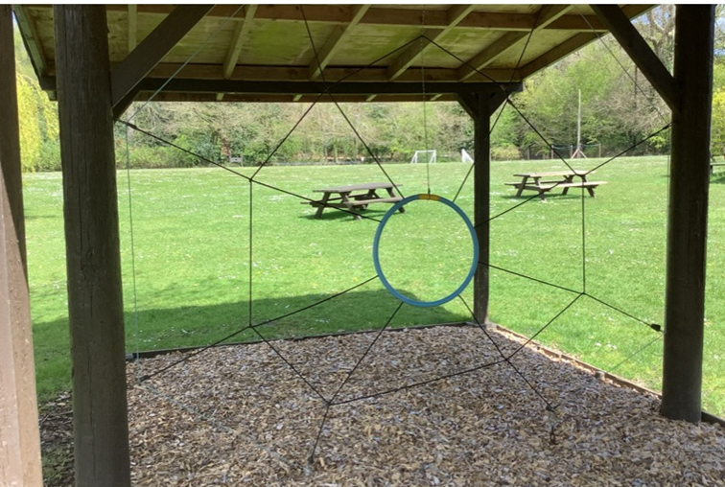
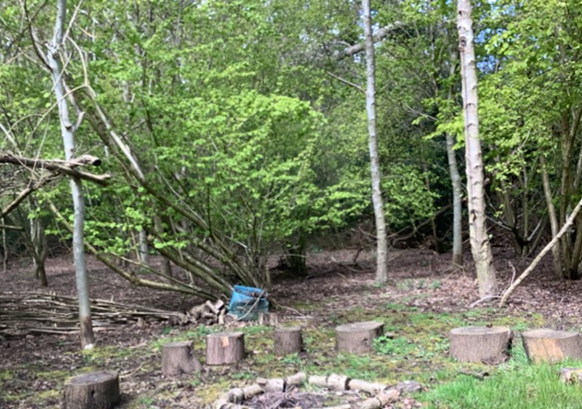
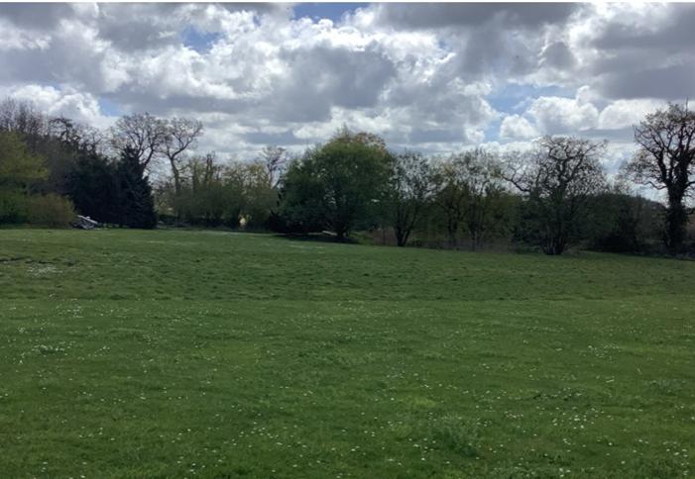
Exploring the grounds

Slide 8

FRIDAY
8.15/ 8.30 AM Pointon/ Donington Arrive at school and go into the hall
8.30/9 AM DEPART FOR AYLMERTON
11.30 AM ARRIVE AND SETTLE IN
12.30 PM LUNCH
(Eat own packed lunch)
1.15 PM AFTERNOON BRIEFING
1.45 PM PIRATE ACTIVITIES AND BUSHCRAFT
5.30 PM EVENING MEAL
7.00 PM EVENING TALK
7.30 PM BINGO
9.30 PM EVENING DRINK

Slide 9
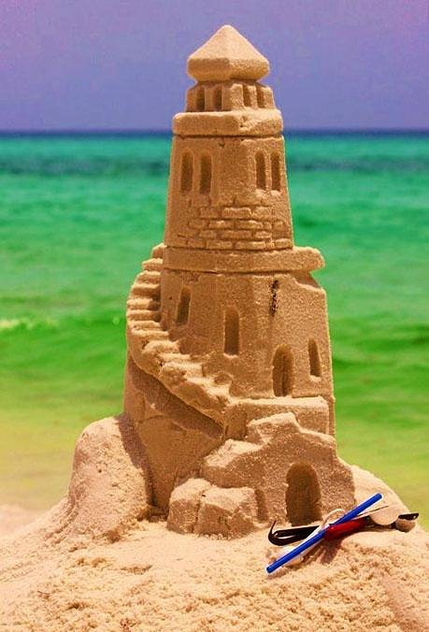
SATURDAY
8.00 AM BREAKFAST
9.00 AM MORNING BRIEFING
10.00 AM TOWN TRAIL AND SAND SCULPTURES
12.45 PM LUNCH
1.15 PM AFTERNOON BRIEFING
1.45 PM COMPLETE PIRATE AND BUSHCRAFT ACTIVITIES
5.15 PM EVENING MEAL
7.00 PM SWIMMING AT THE REEF
9.00 PM EVENING DRINK

Slide 10
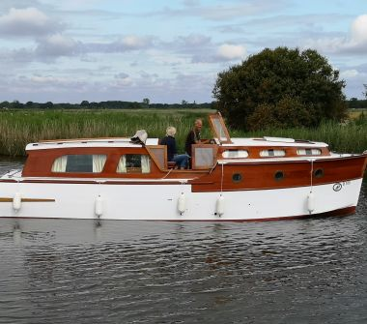
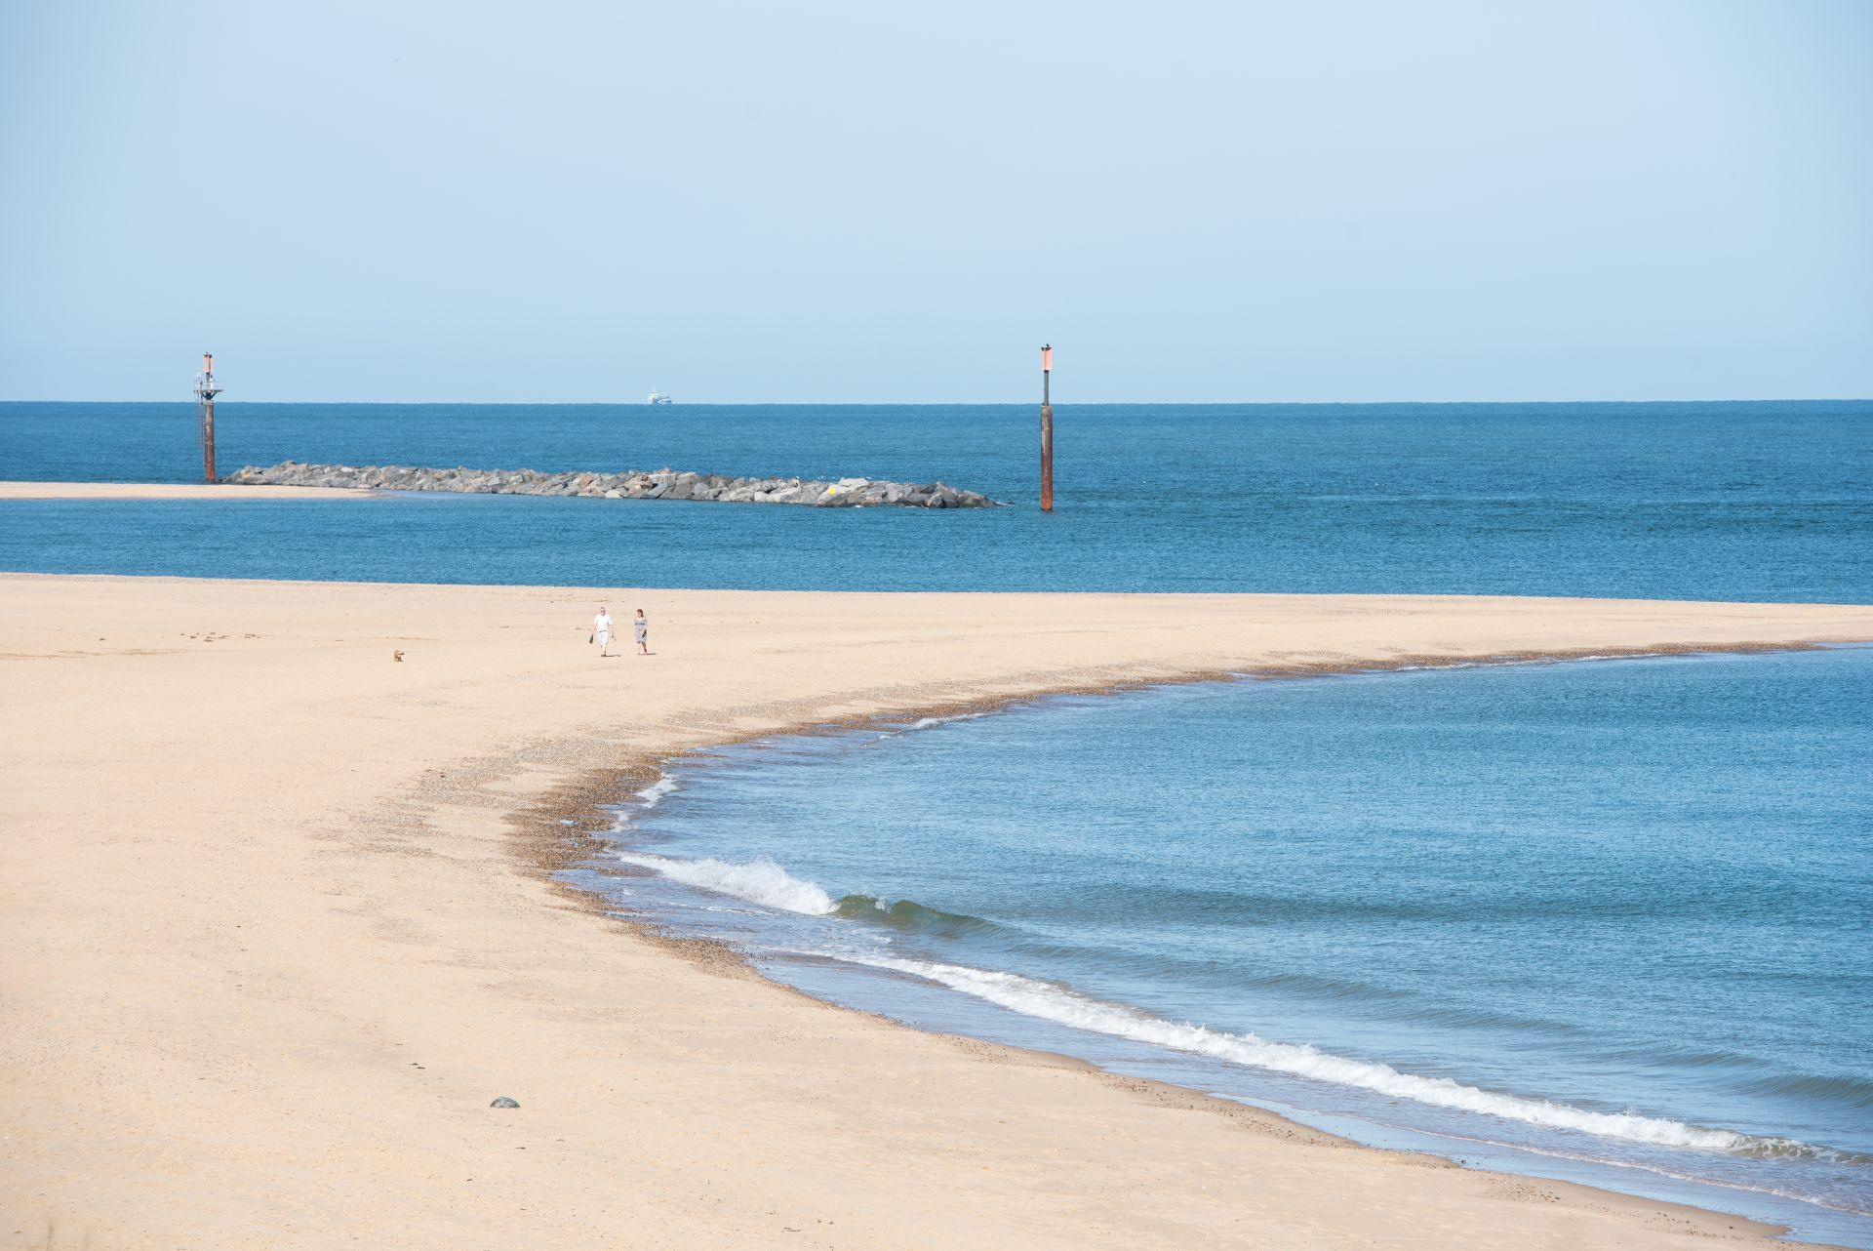
SUNDAY
8.00 AM BREAKFAST
9.00 AM MORNING BRIEFING
10.30 AM BOATS ON THE BROADS
1.15 PM LUNCH
1.45 PM SEA PALLING EXAMINE BEACH
2.45 PM COACH – S PALLING TO HAPPS
3.00 PM HAPPISBURGH EXAMINE BEACH
5.30 PM EVENING MEAL
7.30 PM DISCO
9.00 PM EVENING DRINK

Slide 11
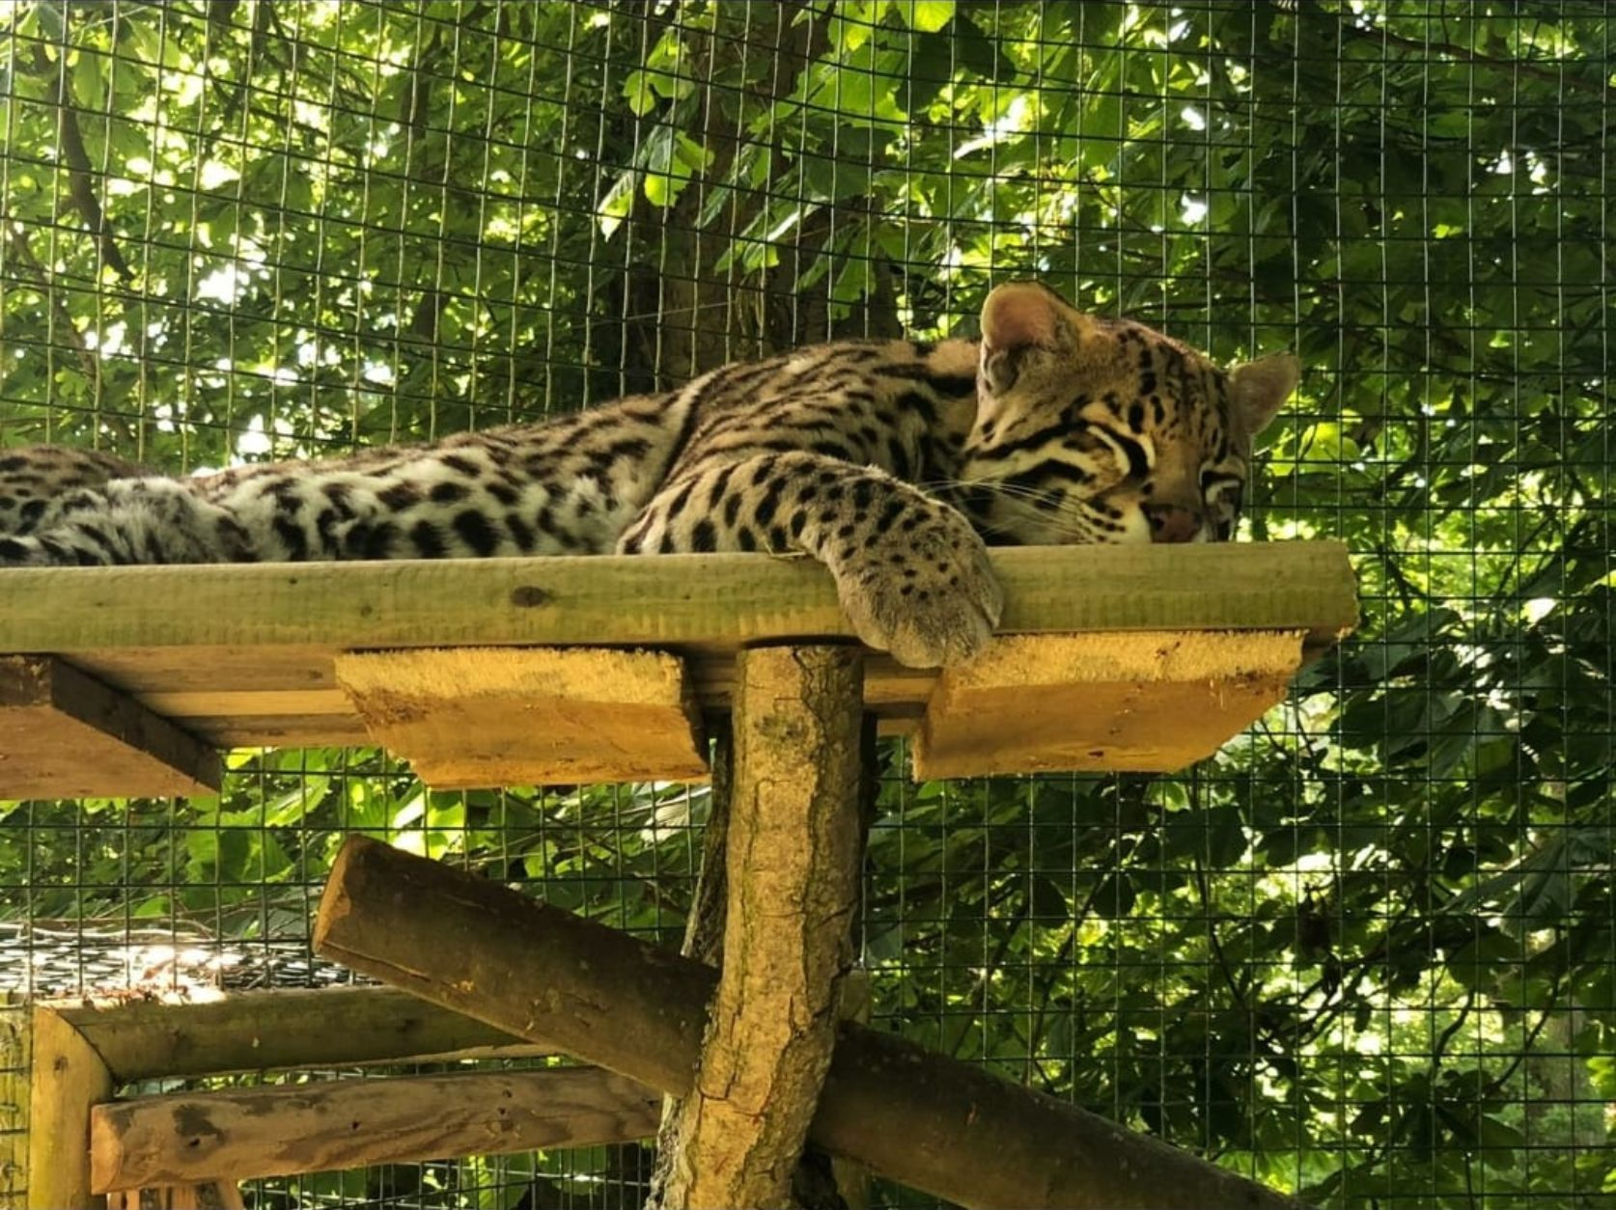
MONDAY
8.00 AM BREAKFAST
10.00 AM VISIT AMAZONA
12.15 PM LUNCH
1.00 PM EMBARK COACH AND DEPART FOR SCHOOL
3.00/ 3.30 PM APPROXIMATE ARRIVAL TIME BACK AT SCHOOL- Donington/ Pointon

Slide 12
What you need:
Behaviour agreement
Kit List
Medication form
Copy of presentation
Check contact details are current
Explore the website:
https://www.afsc.co.uk/
Any Questions?

